Slide 1
Autoencoder
An autoencoder is a type of artificial neural network used to learn efficient data codings in an unsupervised manner. The aim of an autoencoder is to learn a representation (encoding) for a set of data, typically for dimensionality reduction, by training the network to ignore signal “noise”.
As like PCA but there are differences between them, at the last of the topic, we will discuss about it.

Slide 2
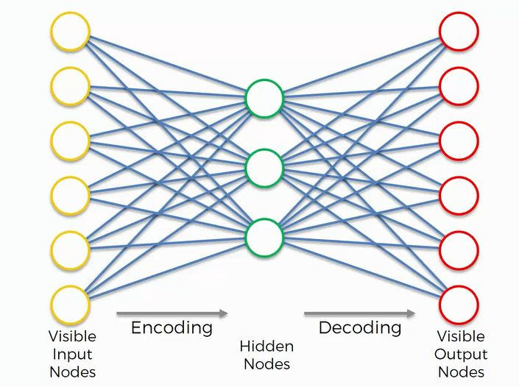
Autoencoder

Slide 3
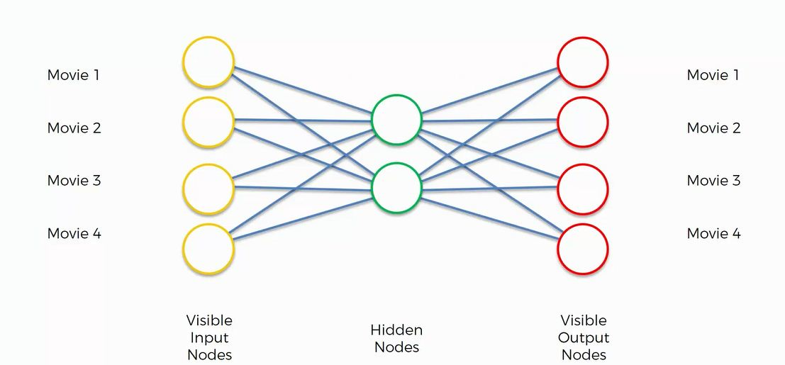
Autoencoder

Slide 4
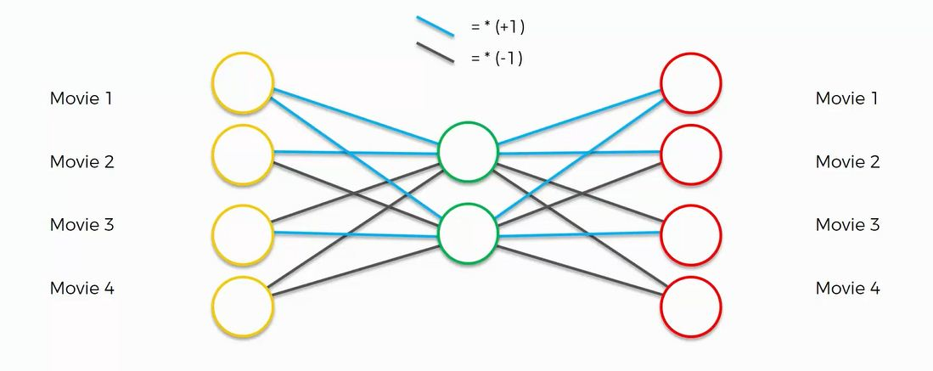
Autoencoder

Slide 5
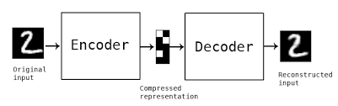
Autoencoder

Slide 6
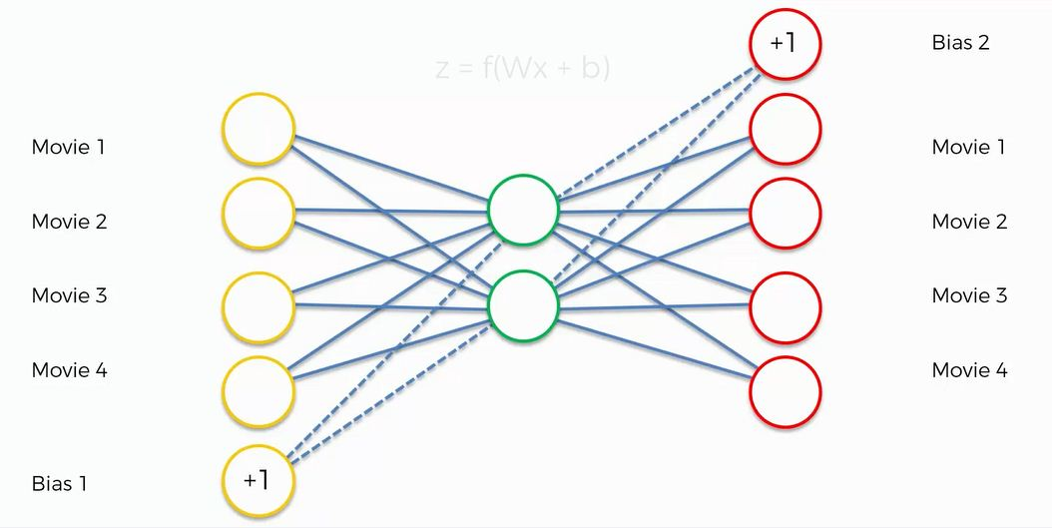
Autoencoder

Slide 7
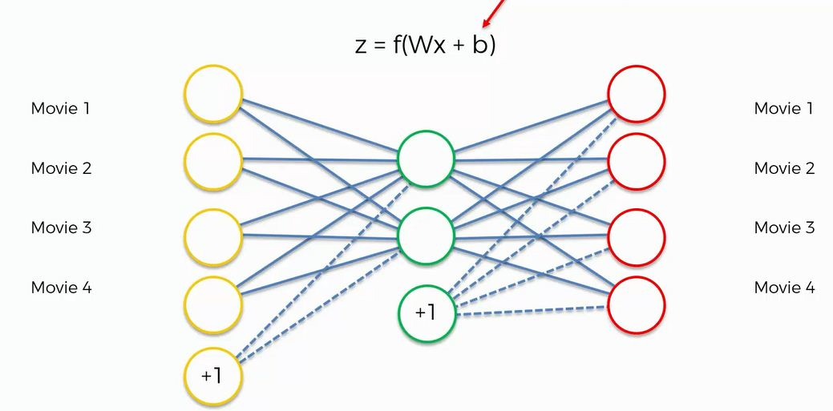
Autoencoder

Slide 8
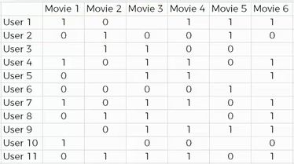
Autoencoder Training

